Slide 1
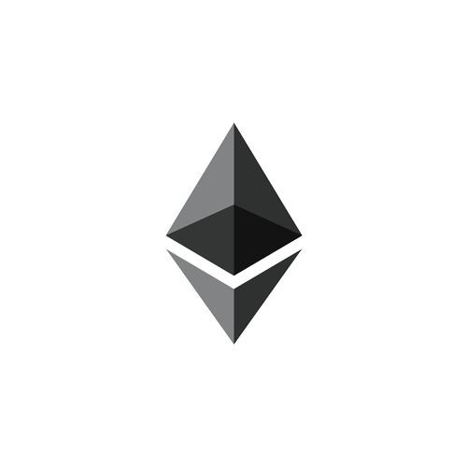
ELECTRONIC HEALTH RECORDS MANAGEMENT USING BLOCKCHAIN
TYROS:
Sumit Hotchandani
Shikhar Bhatt
Kailash Raj Gaur
Shrirang Karandikar
Theme:
Public Health

Slide 2



Problem Statement
‘Punekar’ has to fill out lengthy forms
Goes to KEM Hospital
No interoperability between medical departments and hospitals
KEM
Hospital
No means to track patients medical history
No control over personal medical records
Goes to Sassoon Hospital
‘Punekar’ might forget/not have to bring his previous reports
Loses paper based medical records
Punekar
Sassoon
Hospital
‘Punekar’ has to fill out lengthy forms again
Without medical history doctor might not understand the actual problem
Goes to Pharmacy
Pharmacist is unaware of illegitimate prescriptions
Pharmacy
Customer forgets to bring the prescription

Slide 3
Problem Statement
A big problem faced by the healthcare sector in India is the nature in which medical records are stored.
A majority of the government hospitals still use archaic paper based methods to store records.
Consider your average Punekar getting a health check-up or being admitted at a government hospital.
Every time before being able to avail any service offered by the healthcare centre they have to fill out stacks of paperwork, provide identity proof, pay a deposit upfront and most importantly provide their medical history in order to get an accurate diagnosis and avoid further complications because of a conflicting prescription.
Lack of an EHR system results in reduced interoperability between departments of the same hospital as well as other hospitals which leads to the same problems mentioned above.
It is difficult for a Punekar to keep track of their medical history, a challenge also faced by the hospitals which results in repetitive tests, increase in manual labour leading to inefficacies in the entire process.
All of these little problems lead to increased administrative costs and decreased quality of service which ultimately leads to rise in fatality rates.
The problem that we are trying to solve is the lack of storing records electronically in government hospitals but in the bigger picture the problem being addressed is the delivery of medical services to Punekars in a cost effective and efficient manner.

Slide 4
Solution Overview
The system we propose makes it possible to store medical records on a public blockchain that cannot be manipulated unless patients give permission explicitly.
Everyone on the network — the patients, the doctors, the insurance companies, the pharmacists first establishes identity
Whenever the patient goes to a hospital he provides authentication.
After check up, medical records are uploaded on the network . Records are encrypted using the public key of the patient before uploading.
The network would be running as a Proof of Authority (PoA) chain. It uses a set of “authorities” - nodes that are explicitly allowed to create new blocks and secure the blockchain. The chain has to be signed off by the majority of authorities, in which case it becomes a part of the permanent record. All hospitals in the system would act as authorities
Every request to access records and every request granted are recorded as transactions in the blockchain network.
Due to large data, network may be overloaded .So the records are stored on a decentralized file system IPFS which ensures that there is no single point of failure and redundancy.
Having a system leads to cutting down on costs, labour and a staff that can focus on improving the quality of service offered and help improve the state of healthcare in India

Slide 5


Beneficiaries
Hospitals/Mobile Clinics
Track medical history of patient
Achieve structural interoperability
Ease of record access
Real-time record uploading
Improve delivery of services
Government
Better management of health records
Economization(cost-reduction)
Basis for developing long-term strategy
Citizens
Health records stored securely
Easy to access records
Record portability
Easy to track medical history
Records shared with others to their discretion
Pharmacist
Access to legitimate prescription
Reduce leakage of drugs
Use AI to predict drug stock

Slide 6

Relevance in Smart City
Technology
Blockchain Robust IT connectivity Digitization
Efficiency of Service Delivery
Focus on healthcare-service Structural Interoperability Co-ordination of patient care Transparency
Cost-Effectiveness
Reduction in Administrative Cost Less medical resources being used Less man-power required
Future Applications
Insurance Claims and Processing Predicting disease pattern using AI

Slide 7
Potential Impact
Faster Delivery of Service
Even if records exist digital form ,changes need to be made in official registries, patients need not appear in person to do so as smart contract will establish trust between the doctor and the patient.
Impact Metric - Feedback from patients
Information Exchangeability
Individual hospitals tend to build their own silos of data and information-management protocols, which preclude other parts of the departments or agencies from using them. Information will be shared in a universal format which will minimize the efforts required for collecting and interpreting information.
Impact metric - Ease of creation of service, sharing data decision making .
Security and Control over Data
The use of blockchain ledgers greatly reduces the risk of unauthorized access (through strong encryption) data manipulation (through tamperproof audit trails) that can happen in records stored in digital form.
Impact metric - Cases of fraud reported by patients

Slide 8
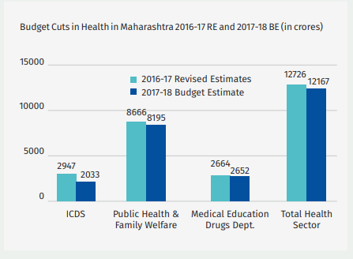
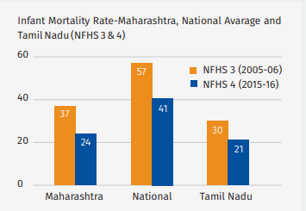
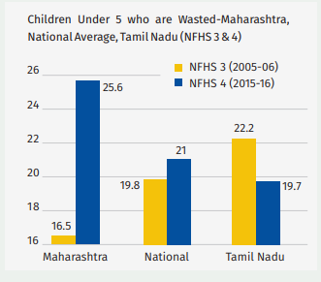
Potential Impact
Maharashtra’s Health Budget
The different indicators given below highlight ways in which Maharashtra is
falling short of taking adequate care of its people

Slide 9
Business Model
Product Features
Revenue Model
Marketing
Version 1
Set up Blockchain Network +
Hospitals +
Punekars(Clients)
Period : 6 to 10 months
Expenditure : 2cr
Revenue : Nil
Pune City
Version 2
Product Marketing
Period : 1 yr
Expenditure : 3.5cr
Revenue : 15-20 lacs
4 Tier 1 cities
Version 3
Product Marketing +
Pharmacists
Period : 1 yr
Expenditure : 6cr
Revenue : 35-40 lacs
10 Tier 2 cities
Version 4
Product Marketing +
Insurance companies
Period : 1.5 yrs
Expenditure : 10cr
Revenue : 60-70 lacs
15 Tier 3 cities
Note: For Versions 3&4, partnership with established IT firms for large scale deployment of software
as well as training.

Slide 10
Ease of Implementation
Infrastructural Requirements
Virtual Machines(VMs) on any cloud service provider(Azure, AWS)
Mobile phones and desktop computers with internet connectivity.
IT enable the hospitals – establish network, hardware including bio-metric module
Stakeholders
Medical records will be accessed over the Internet demanding people to be familiar
with internet.
People with internet access can avail the services using web application.
People without internet access can visit the nearby hospital and avail the service
(using bio-metric authentication).
For hospitals, shifting from their traditional/current system to blockchain based
scheme might be challenging but the future outcome would be highly beneficial.
Partnership with MNCs for large scale deployment of software as well as training.

Slide 11
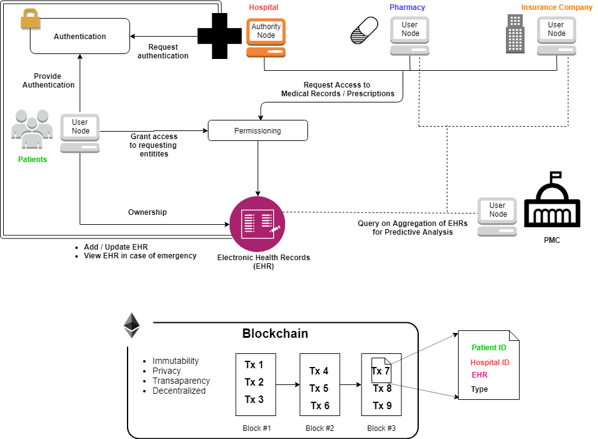
Architecture Diagram

